Slide 1


An introduction to programming
Using scratch and pseudocode

Slide 2

Day 1: Introduction to scratch
Concepts to be covered:
Working with sprites and costumes
Working with background
Understanding the coordinate system
Say, ask and join commands
Understanding variables and operators

Slide 3
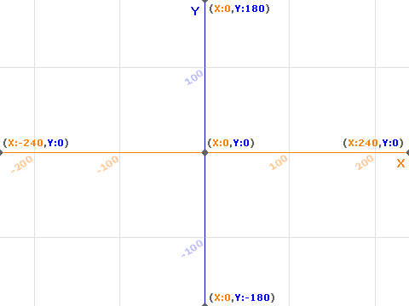
The coordinate system in scratch

Slide 4

Day 1 classwork questions:
Ask the user for x and y coordinates and take the sprite to the location
Ask user for their name and say “Hello (name)”
Take the sprite to a specific location of your choice and make it say the coordinates[for example: if it is at (20,30) it should say “I am at x-coordinate of 20 and y-coordinate 30”]
Ask the user for 2 numbers and say their product
Ask the user for their age and tell them in how many years they’ll turn 100

Slide 5


Day 2: Conditionals and iterations in scratch
Concepts to be covered:
Conditional statements
Loops

Slide 6

Day 2 classwork questions:
Ask the user for their age and tell if they are an adult or not (for reference: adult is anyone who is 18 years old or more)
Ask the user for a password, and ask them to repeat it. If the 2 dont match, tell the user there is an error.
Ask the user for x,y coordinates, and if the coordinates are within the screen limit, take the sprite there, otherwise tell there is an error
Number guessing game: the computer will choose a random number between 1 and 50, and the user has to keep guessing until they get it correct. The program will keep giving user hints(eg: your number is less than the chosen number)
Ask the user for a number of terms and keep adding all of them. Print the total sum at the end

Slide 7

Day 3: Pseudocode
Concepts to be covered:
print hello world
input/output
Variables, setting values in variables, defining
Operators
Dry running

Slide 8
Day 3 classwork questions:
Ask the user for 2 numbers and print their product
Ask the user for their age and print in how many years they will turn 100 years old
Ask the user for their age and tell if they are an adult or not
Dry run all the above questions

Slide 9
Day 4: Pseudocode
Concepts to be covered:
Conditional statements
Loops

Slide 10
Day 4 classwork questions:
Input age of user and tell if they are an adult or not
Design a grading system [A: 100-90, B:90-80, C:80-70, D:60-50, E:50-40]
Write a loop which prints all multiples of 4 until 100.
Prime number checking
Dry run all the above questions

Slide 11
Day 5: Custom blocks in scratch
Concepts to be covered
Custom blocks
Making a calculator using custom blocks

